Slide 1


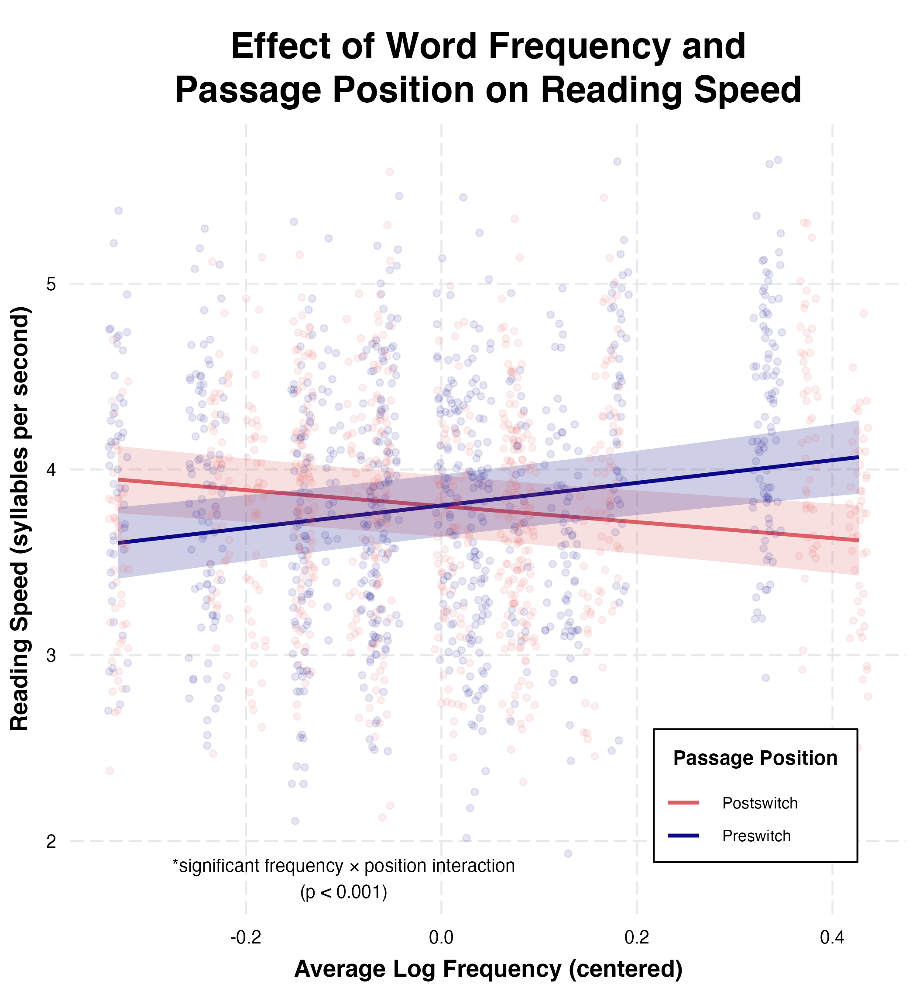
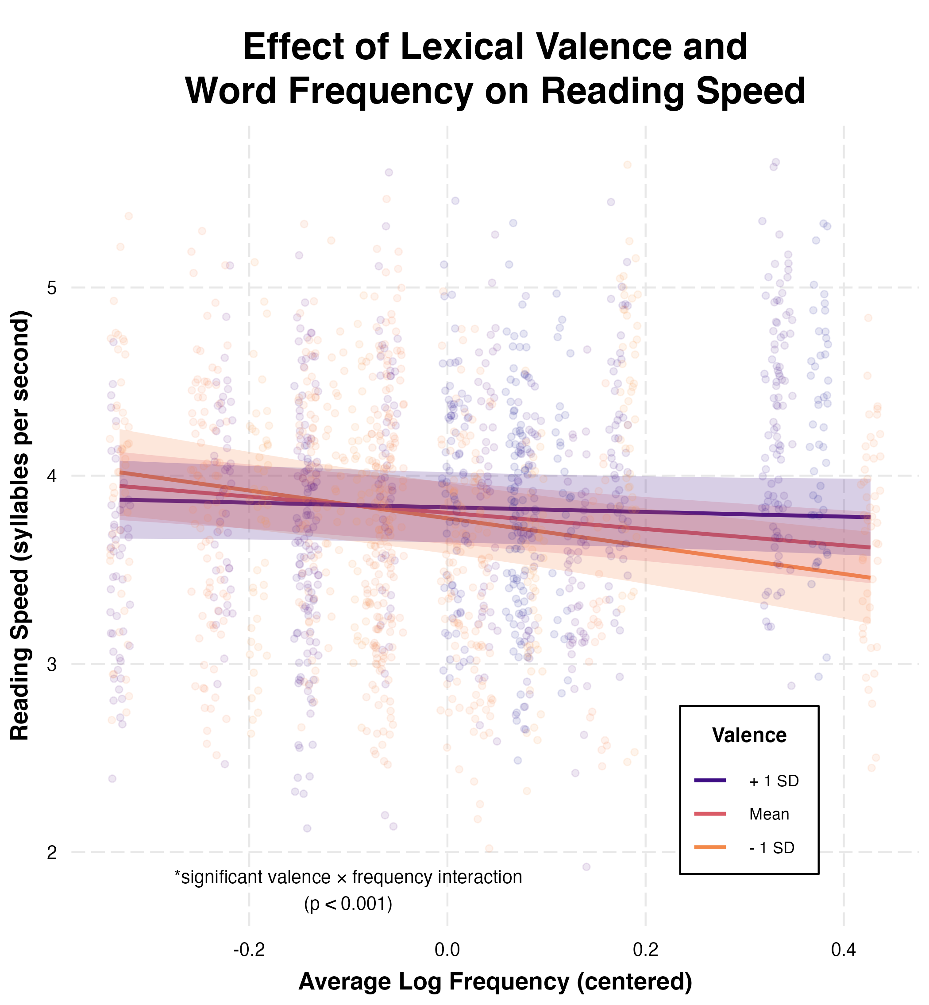
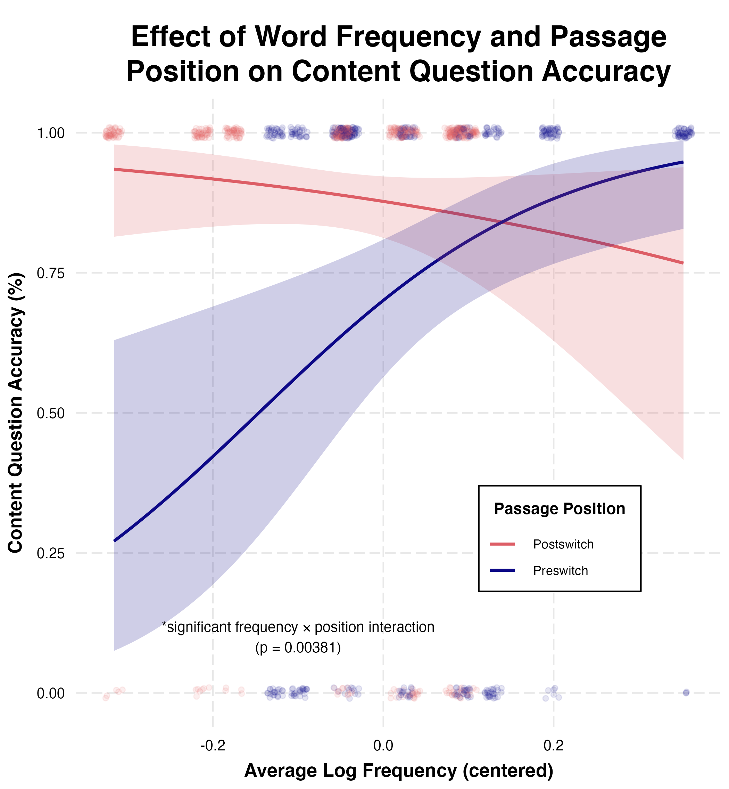
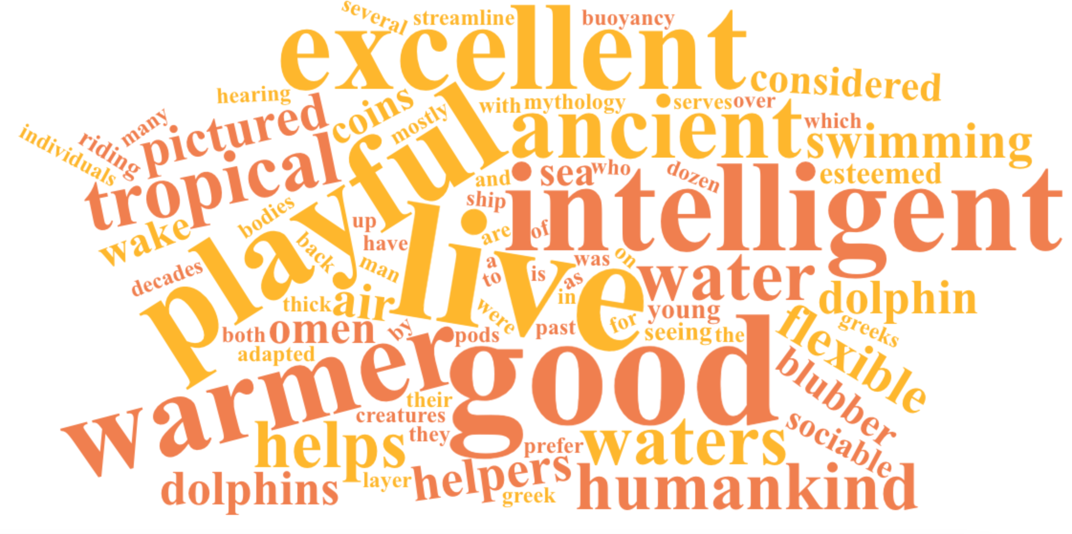
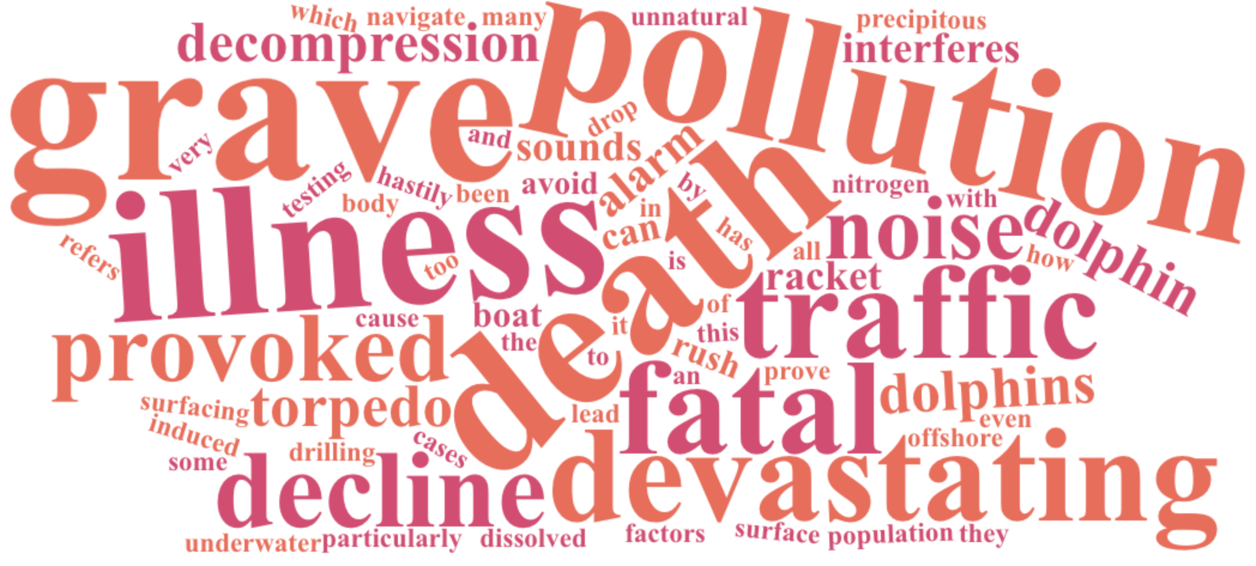
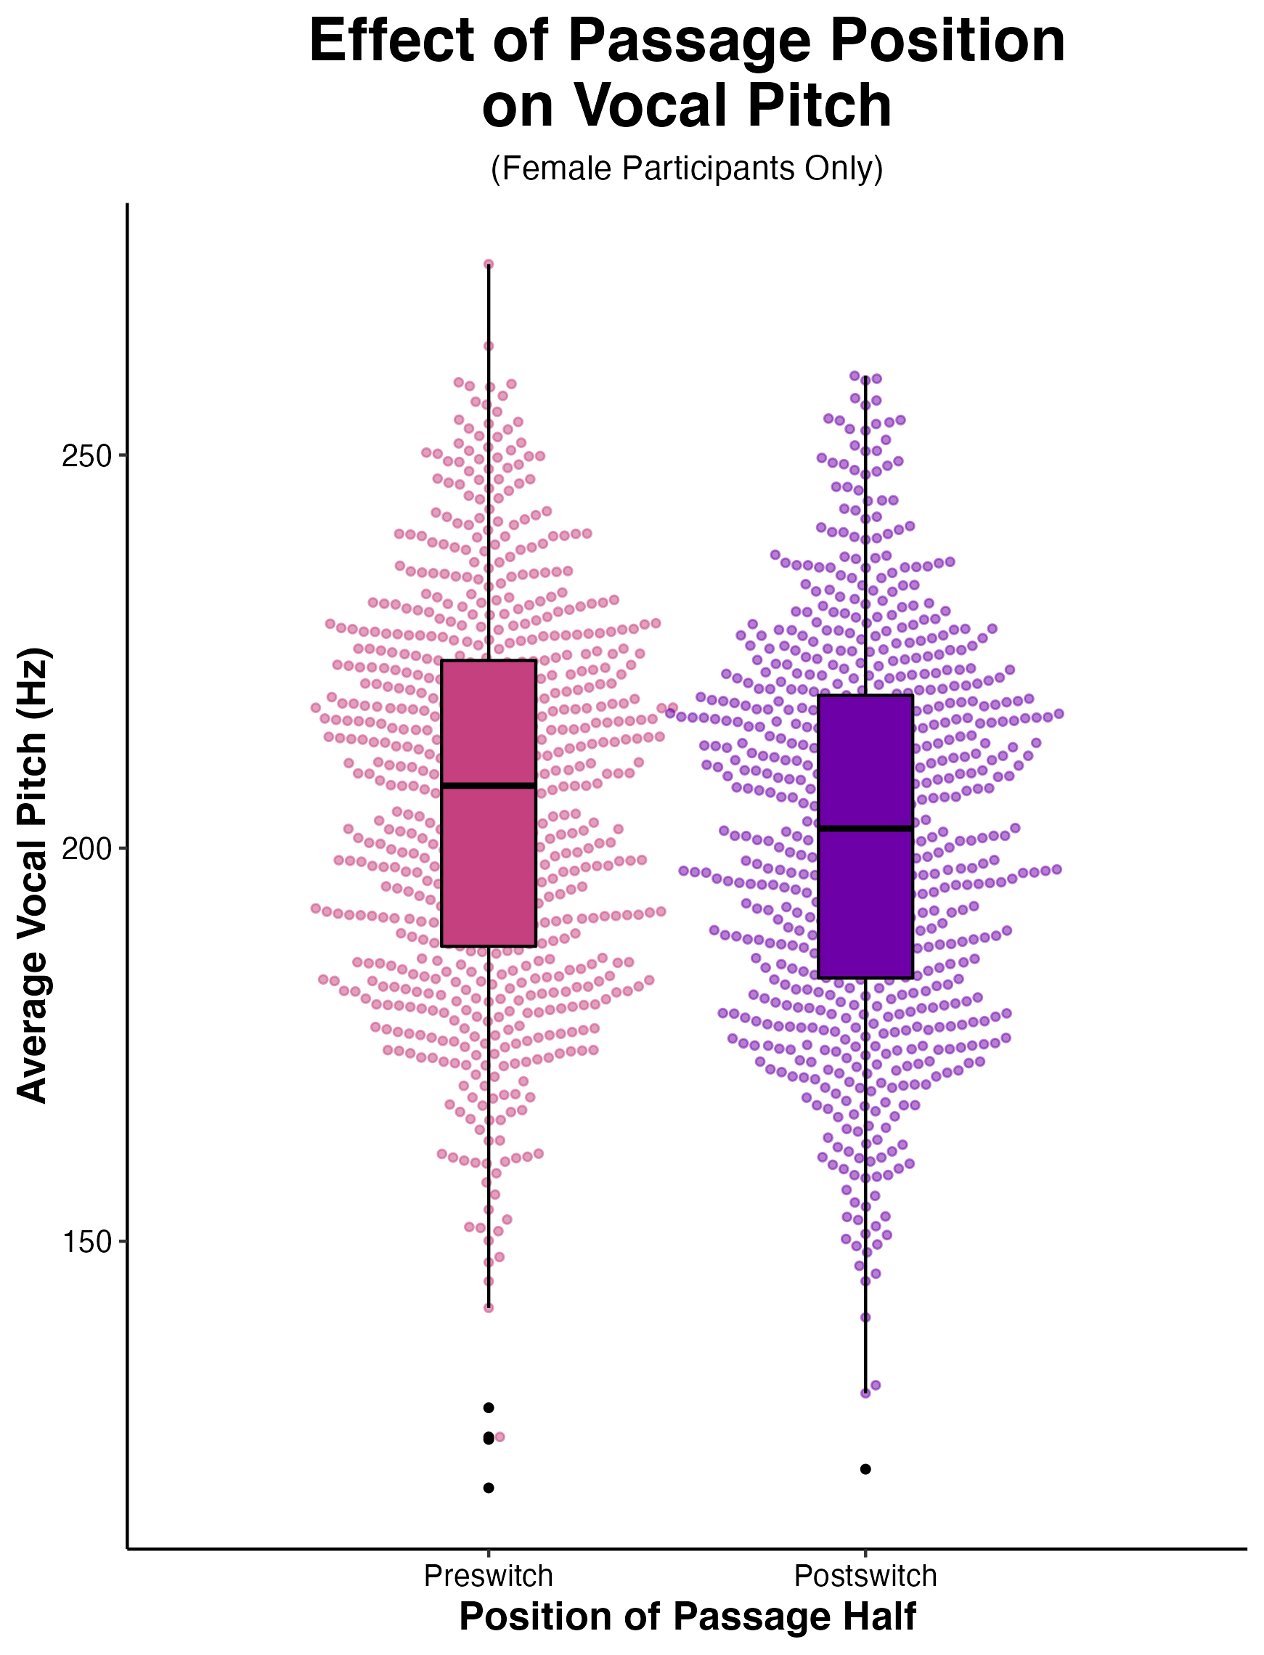
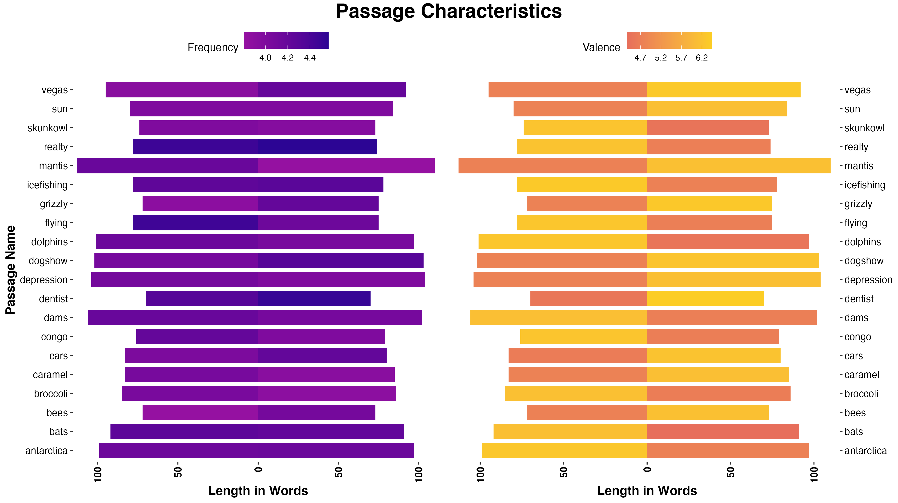

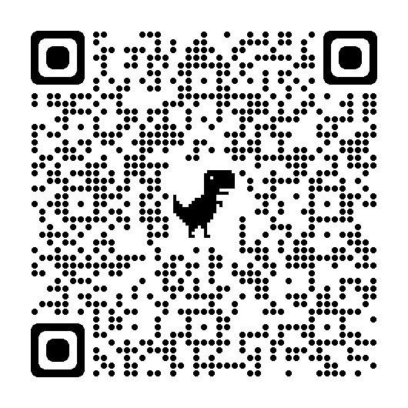

Effects of Lexical Valence and Emotional (In)Congruency in Naturalistic Reading Aloud
Jessica M. Alexander¹, Ana Lopez-Nuñez¹, Brittney M. Rodriguez¹, Anfernee N. Duncombe¹, Sarah B. Malykke¹, George A. Buzzell¹
¹Florida International University
BACKGROUND
How does emotional context across a textual passage interact with lexical features (average word frequency) to predict natural oral reading behavior?
Highly controlled, laboratory studies demonstrate effects of word-level characteristics (e.g., word frequency, emotional valence) and their interaction(s) on reading behavior.^{1,2,3}
Likewise, laboratory studies reveal that effects of word-level attributes on reading behavior are moderated by higher-level semantic context (e.g., sentence-level word position)⁴ or task demands.⁵
Given that higher-level context and task demands are known to impact effects of word-level characteristics on reading behavior, the use of highly constrained experimental reading paradigms may obscure behavioral dynamics in naturalistic visual sampling and self-pacing at the multi-sentence level.
In the current study, we used a naturalistic oral reading paradigm, recorded outside the laboratory environment. Passages were designed with reversals in (mean) word valence mid-passage to probe effects of emotional context and its consistency; passages naturally varied in (mean) lexical frequency.⁶
METHODS
Participants
55 FIU students (M age = 23.4, SD = 4.7; 50 F, 4 M)
Absent communication disorders; learned English prior to age 6
Race/Ethnicity: 76% Hispanic, Latino/a/x, or Spanish Origin; 13% White; 6% Asian; 2% American Indian or Alaska Native; 2% Black or African American; 2% Undisclosed
speed/accuracy: 54 participants with usable data
-1 removed due to accuracy < 60%
pitch: 48 participants with usable data
-2 removed due to poor audio quality
-4 male participants removed, given known differences in M/F pitch
Analyses
Mixed effects models with random intercepts per participant and passage. Position variable contrast coded (preswitch: -1, postswitch: +1). Continuous variables mean centered across participants.
lmer(speed ~ position (pre/post) * valence * frequency + (1|id) + (1|passage))
lmer(pitch ~ position (pre/post) * valence * frequency + (1|id) + (1|passage))
glmer(accuracy ~ position (pre/post) * valence * frequency + (1|id) + (1|passage), family=”binomial”)
Stimuli and Procedure
20 passages: each 140-230 words, one half positive/one half negative (Warriner valence⁷).
Switch order counterbalanced: ½ start positive and switch to negative (pos2neg), ½ start negative and switch to positive (neg2pos).
Participant audio files manually annotated for onset of first syllable, onset of first syllable in switch word, and coda conclusion in last word.
“Read at your normal volume and speed...”
passage text
comprehension
question
DISCUSSION
Speed of reading aloud in a naturalistic context is sensitive to traditional frequency effects when emotional context remains constant.
The mid-passage shift in valence results in a reversal of traditional frequency effects, such that reading speed for low-frequency words is facilitated whereas high-frequency words become relatively impaired.
The mid-passage shift also appears to result in a relative increase in reading comprehension for low-frequency passages that follow the switch (i.e., the increase in low-frequency passage reading speed cannot be explained by a speed-accuracy tradeoff).
Given the experimental design, at least two interpretations are possible:
The abrupt switch in emotional context may produce an expectancy violation, and a shift from System 1 to System 2 processing (i.e., a shift towards information gathering and more in-depth information processing).^{8,9}
Given that shifts in emotional valence always occurred mid-passage, changes in the relative speed and comprehension of low-frequency passages could be explained by position alone (i.e., increased exposure to an emotionally-biased context serves to pre-activate emotionally-laden words, which facilitates reading and comprehension of low-frequency words in particular).¹⁰
Irrespective of position (pre-/postswitch), valence interacts with average word frequency to predict reading speed. Within more negative passage halves, reading speed of low-frequency words is facilitated.
The mid-passage shift in valence also leads to lower F0. (Note: pitch was only analyzed for females, due to an insufficient number of males in the participant pool.)
REFERENCES
Kuchinke et al. (2007) Int. J. Psychophysiol.
Scott et al. (2012) J. Exp. Psychol. Learn. Mem. Cogn.
Kuperman et al. (2014) J. Exp. Psychol. Gen.
Payne et al. (2015) Psychophysiology
Fischer-Baum et al. (2014) Lang. Cogn. Neurosci.
Brysbaert & New (2009) Behav. Res. Methods
Warriner et al. (2013) Behav. Res. Methods
Stanovich & West (2000) BBS
Kahneman (2011) Thinking, Fast and Slow
Chou et al. (2020) CABN
Example Passage
Dolphins are intelligent sea creatures who mostly prefer warmer, tropical waters. A thick layer of blubber helps with buoyancy and serves to streamline their flexible bodies. They have excellent hearing, which is adapted for both air and water. Sociable and playful, dolphins live in pods of up to a dozen individuals. In Greek mythology, dolphins were esteemed as the helpers of humankind. Seeing dolphins swimming in the wake of a ship was considered a good omen by the Ancient Greeks and many ancient coins pictured a young man riding on the back of a dolphin.
Over the past several decades, the devastating decline in the dolphin population has been the cause of grave alarm. This precipitous drop has been provoked by many factors, particularly noise pollution. Noise pollution refers to the underwater sounds of boat traffic, torpedo testing, and offshore drilling. All this unnatural noise is very stressful to dolphins. It interferes with how they navigate and can even prove fatal: in some cases, dolphins rush to the surface to avoid all the racket. Surfacing too hastily can cause decompression sickness, an illness induced by dissolved nitrogen in the body and which can lead to paralysis and death.
preswitch < > postswitch
preswitch < > postswitch
CONNECT
jalexand@fiu.edu
je55bot
counterbalanced
*significant effect
of position
(p < 0.001)
Scan for PDF & analysis code:
Example Comprehension Question
What is the typical size of dolphin pods as mentioned in the text?
a. 2 | b. 12 | c. 20 | d. 100
positive half
> 6.1 on valence scale
switch
pos2neg: < 2.5
neg2pos: > 7.4
negative half
< 4.3 on valence scale

